Slide 1
BioBottle Data Table
Date: Astronaut Status (dead or alive) Make 3 Qualitative Observations & 3 Quantitative Observations
Date: Astronaut Status (dead or alive) Draw a quick diagram of the Nitrogen cycle in your bottle ecosystem.
Date: Astronaut Status (dead or alive) Name 2-3 limiting factors that occur in your biobottle. How do these limiting factors negatively impact your astronaut.
Date: Astronaut Status (dead or alive) Describe you most successful biobottle feature! (structure/decision/innovative design)
Date: Astronaut Status (dead or alive) Describe the Niche of your organism.
INB Pg. 28

Slide 2
Why read about Bioethics?
The fallacy of bioethical distance: “It can’t happened to me.” We all might face a bioethical decision in our lifetime.
As Americans, we have the right to participate in political processes, and our responsibility to inform ourselves in order to make thoughtful decisions.

Slide 3
CNN-Ashley case video clip
http://viewpure.com/YDCA6a9WDFc?start=0&end=0

Slide 4
Final Word Conversation
1. Move your chairs around one table.
2. Each Group will have one timer. (you can use a phone)
3. Select 1 person to go “first” They have 1 minute to answer the 1st question below:
1st Student: Do you think its ethical to preform non-life saving surgery on a person who cannot give consent? Why…provide evidence from the article
2nd Student: Do you agree with what the doctors did? Provide a piece of evidence. What would you change or do different?
3rd Student: What aspect of the treatment do you agree or disagree with most?
4th Student: What other types of people could this apply to? Ultimately, do you think parents should be the final decision makers about medical treatment for their child? Why or Why Not?
4. Each person has 30 seconds to respond to the 1st persons comments (Do not answer your question…..your turn is coming!) Once you respond, make a check mark on your board
5. After everyone has responded, the person who began has the “final word.” That person needs to respond to what has been said, What is his/her reaction? (They then make a check mark on the board)
6. A new person will have 1 minute to answer his/her question and the process repeats.
7. At the end, each student should have 4 check marks on the board.
After the discussion
Answer the questions on the back of your article:
Is it ethical to preform non-life saving surgery on a person without their consent? Yes or No
Pick THREE opinions from the text that support your position (write down the page and paragraph #). State whether you agree/disagree AND why!!!!!
Pick a fact or piece of evidence from the text that help you make your decision and supports your decision.

Slide 5
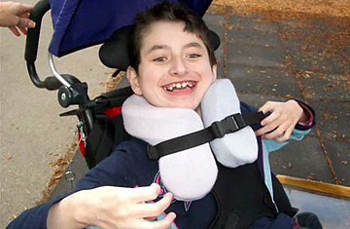
After the TesT….Pillow Angel Ethics Article
1st step: number each paragraph (16 total)
2nd step: read a paragraph’s and CIRCLE any FACT
Does NOT go in INB!
3rd step: Read the paragraph again. Underline any opinions. By each opinion write A for agree or AD for disagree. Next to the A or D write a very short statement describing why you agree or disagree.
4th Step: complete this process of the entire article

Slide 6
Pillow Angel Article Checklist:
1st step: number each paragraph (16 total)
2nd step: read the first three paragraph’s and CIRCLE any FACT
3rd step: Read the first three paragraph’s again. Underline any opinions. By each opinion write A for agree or D for disagree. Next to the A or D write a very short statement describing why you agree or disagree.
4th step: highlight the glossary terms in the article.
Answer the questions on the back of your article:
Is it ethical to preform non-life saving surgery on a person without their consent? Yes or No
Pick THREE opinions from the text that support your position (write down the page and paragraph #). State whether you agree/disagree AND why!!!!!
Pick a fact or piece of evidence from the text that help you make your decision and supports your decision.

Slide 7
Science 100% Club
You will get tests back.
Those that missed ZERO questions, will enter the 100% Club ☺

Slide 8
Biology Test Corrections
Test Question | Original Answer | Correct Answer | Why I know this is the correct answer…You must provide a scientific explanation
1 | B | A | Hetero means different. These organisms must gain energy through consumption of plant/animal tissues.
To find the answers and your scientific explanation, use your NOTES and/or textbook!
*Staple to test sheet when finished. You cannot take test home.

Slide 9
Biochemistry Pre-test
Name a type of sugar.
What are the four major types of macromolecules?
What are substances termed that contain a pH of 7 or more?
Provide an example of a nucleic acid.
A __________________ helps speed up a chemical reaction.
What are the five main elements of living things?
What substance is considered the universal solvent?
Describe why water can move up a plant.

Slide 10
Biochemistry Pre-test
Name a type of sugar.
What are the four major types of macromolecules?
3. What are substances termed that contain a pH of 7 or more?
4. Provide an example of a nucleic acid.
5. A __________________ helps speed up a chemical reaction.
6. What are the five main elements of living things?
7. What substance is considered the universal solvent?
8. Describe why water can move up a plant.
Glucose, ribose, fructose, maltose, etc
Carbs, lipids, proteins, nucleic acids
Basic
DNA, RNA, ATP
Catalyst/enzyme
Carbon, Hydrogen, Oxygen, Nitrogen, Phosphorus
Water
Cohesion & Adhesion… powered by evaporation

Slide 11
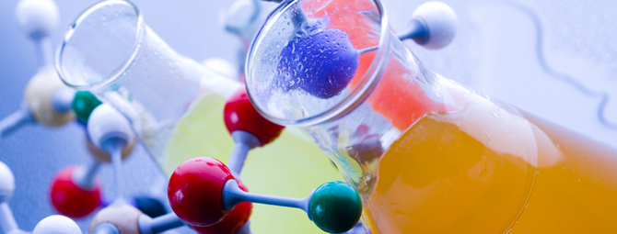
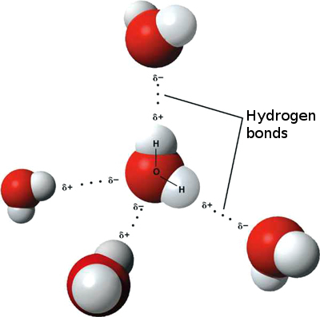
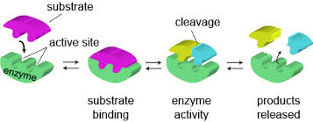
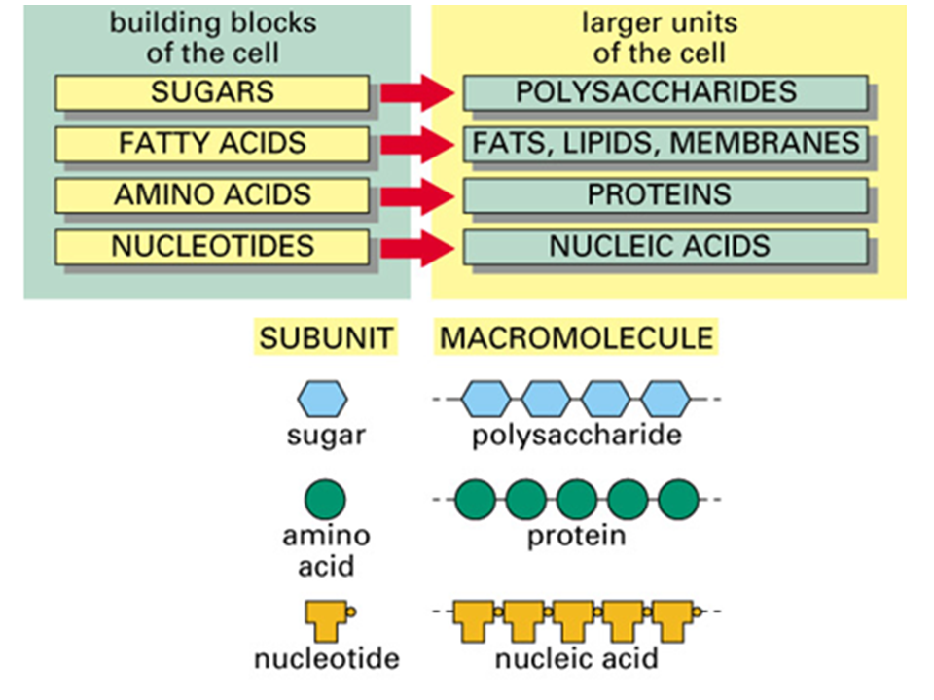
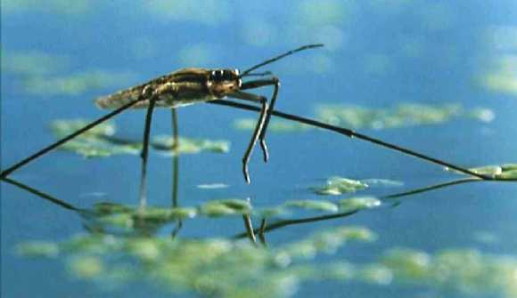
Unit #3 Biochemistry

Slide 12
Water Notes
Where there is LIFE, there is WATER!
Life on Mars?

Slide 13
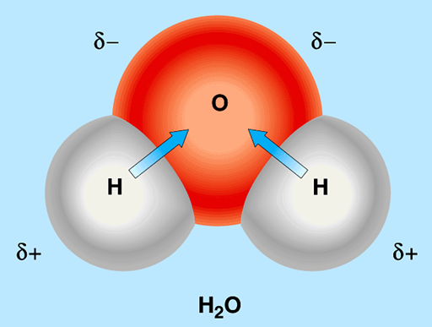
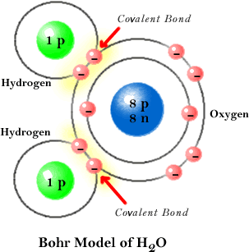
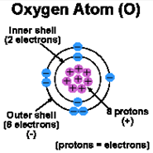
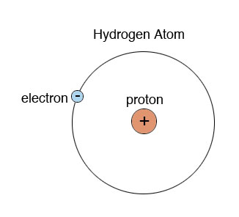
Water (H₂O)- Molecular Structure
Bent
Charged on both ends (polar)
*Waters (O-H) bond is very hard to split….. Only plants can do it!
What you need to know-
Different properties of H2O
Their biological significance
How each property is determined by water’s molecular structure

Slide 14
Properties of H2O
1. H2O is POLAR
-unequal distribution (sharing) of charges
-How detergents work: they are charged at one end (polar), and uncharged at the other end (nonpolar)
Ex. Soap
Biological Significance:
1. Cell membrane- ½ polar and ½ nonpolar….which creates a barrier protecting the inside of the cell.
http://www.chemistryland.com/CHM130S/13-Liquids/LiquidsSolutions.html#

Slide 15
2. H2O is an excellent solvent (aka… dissolves things well)
Salt: NaCl
- Water is charged at both ends, which allows it to bond to any charged molecule
Biological Significance:
Bloodstream… dissolves sugars/proteins
Waste excretion (urine)
Plants use water to absorb nutrients

Slide 16
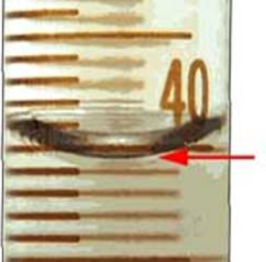
3. Adhesion & Cohesion
Cohesion- water sticks to water (polar)
Adhesion- water sticks to other charged molecules
Biological Significance:
H2O can travel up trees from roots to leaves
-H2O is “pulled up” by evaporation
-H2O sticks to xylem (charged) transport system

Slide 17
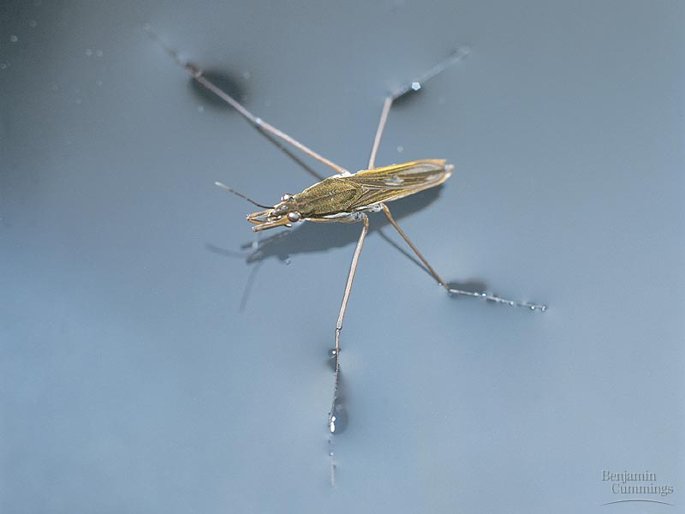
4. Surface Tension
-H2O forms a blanket at the surface because of cohesion
-soap can break surface tension because its polar end clings to water and its nonpolar end pulls away
Biological Significance:
Organisms can “walk on water” to find mates, food & escape predators
http://www.youtube.com/watch?v=Oe3St1GgoHQ
https://www.youtube.com/watch?v=45yabrnryXk

Slide 18
5. High Heat Capacity
-H2O resists temperature change
Why? A high amount energy is needed to be added or removed in order to heat or cool H2O.
*its difficult to get that many small molecules to move or stop
Biological Significance:
Oceans maintain steady temperatures throughout the year (ocean life can regulate body temp.)
Sweating cools body (hottest water molecules leave & cooler water molecules remain)

Slide 19
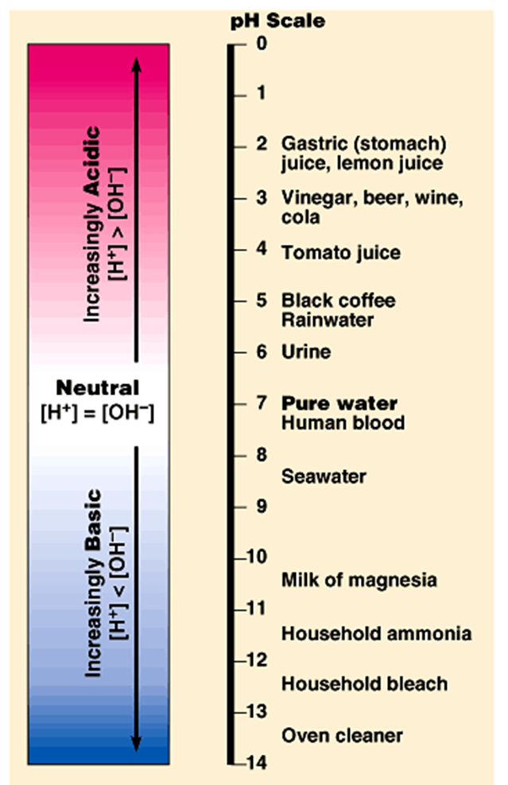
6. pH of H2O scale
-pH (potential Hydrogen)
Ionization of H2O: H₂0 ----> H⁺ + ⁻OH
H⁺ (hydrogen ion) ⁻OH (hydroxide ion)
*Acids (pH 1-6) ex. Stomach acid, lemon juice.
-release more H+ into solutions
*Bases- (pH 8-14) ex. Soap, bleach
-release more OH⁻ into solutions
Biological Significance:
Chemical reactions in cells function in a specific pH (6.5- 7.5)….around neutral
*Buffers (weak acid or base) are dissolved in body fluids to stabilize pH

Slide 20
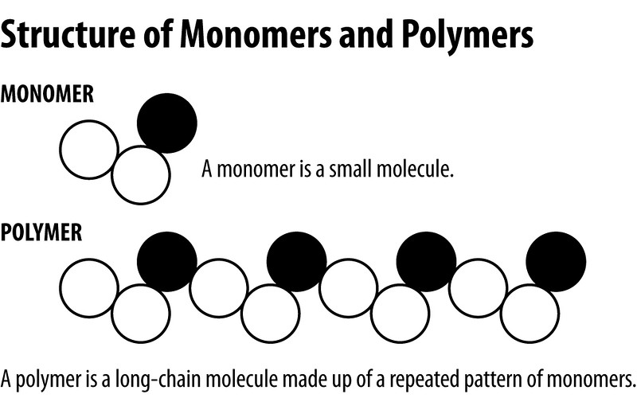
Macromolecule Chart
Polymerization- large carbon compounds(polymers) are formed by joining together smaller compounds (monomers)
-way to form complex molecules
ex. alphabet (26 letters, makes many words)
INB pg. 33

