Slide 1
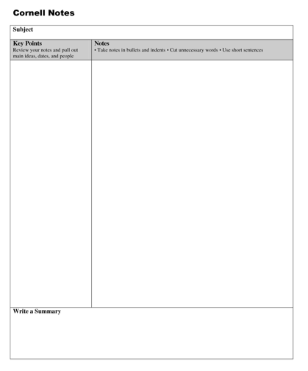
EQ: How does your body grow and repair itself?
Title: The Life of a Cell
INB page. 46

Slide 2
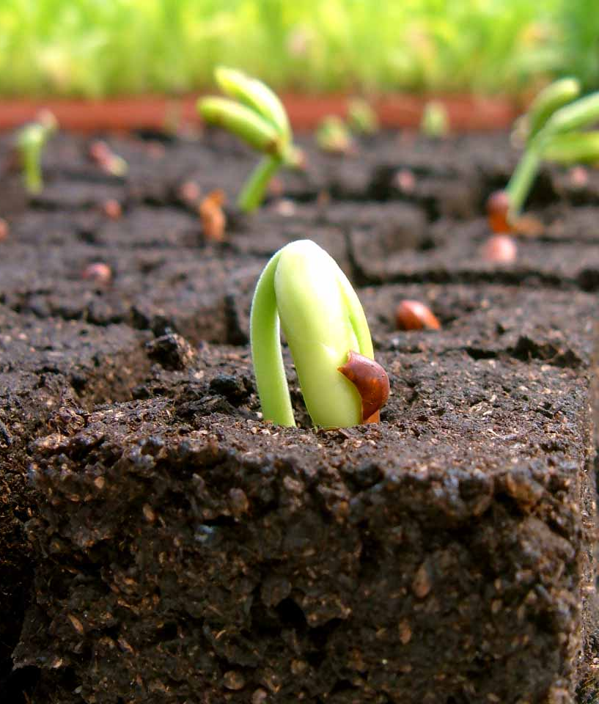
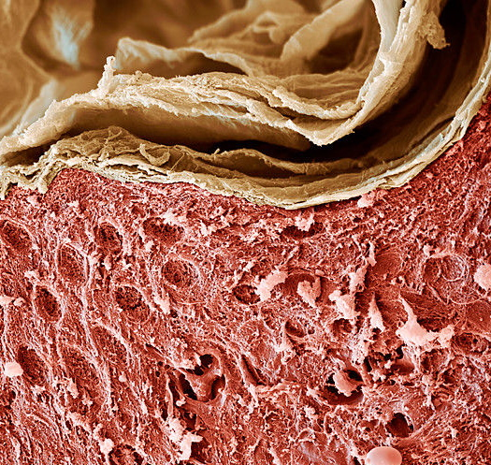
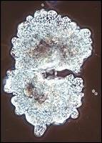
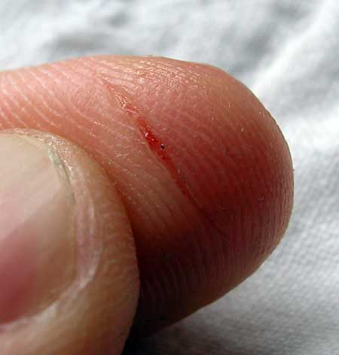
A. Why do cells divide?
Repair/replacement of dead or injured cells
Growth (more small cells)
Asexual reproduction
http://viewpure.com/DtBUM51t4iw?start=0&end=0

Slide 3
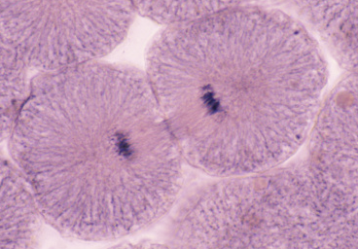
B. Cell Cycle
Mitosis:
Division of nucleus & DNA
Mitosis
Cytokinesis
Cytokinesis:
Division of 1 cell into 2 (genetically identical)
Interphase
Interphase:
-cell makes more cell parts….GROWS!
-doubles DNA

Slide 4
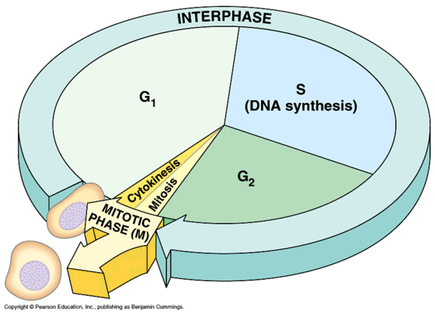
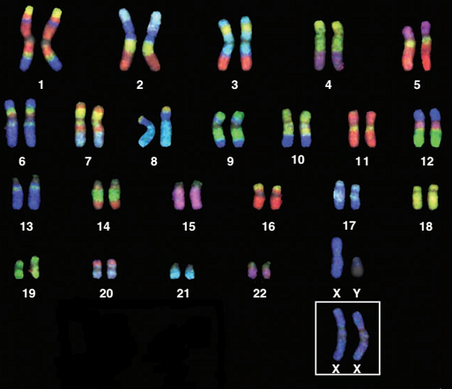
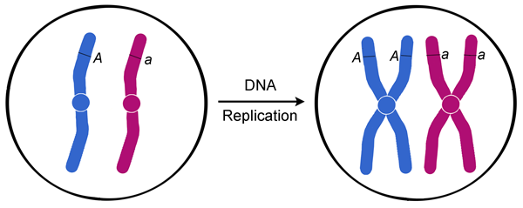
C. Phases of Mitosis
1. Starts with parent cell:
-chromosomes (long strands of DNA)
-chromosomes come in pairs called HOMOLOGOUS Chromosomes (same length,
1 from each parent).
-during interphase every
chromosome doubles =
2 of each homologous pair
Maternal chromosome
Paternal chromosome

Slide 5
2. Prophase: nucleus membrane disappears, chromosome pairs are visible
3. Metaphase: fibers line up duplicated pairs in the middle.
4. Anaphase: duplicated pairs are pulled apart to opposite ends of the cell.
5. Telophase: nuclear membrane reappears in both daughter cells, new cells begin interphase.

Slide 6
Cell Division Stop Motion Project:
-You will work with your row (4 people)
-At least ONE member of your group needs to download a FREE stop-motion video app for use in class tomorrow
Examples:
-PicPac
-Stop Motion Studio
-Stop-Motion Movie Creator
Train your Brain to stay focused and improve studying!
http://viewpure.com/reVq-RPaHLI?start=0&end=0

