Slide 1
INB pg. 20
Writing Scientific Conclusions (CER):
Claim: one sentence that answers the experimental question
Evidence: observations/data to support the claim
Reasoning: how/why the data supports the claim (includes scientific principles)

Slide 2
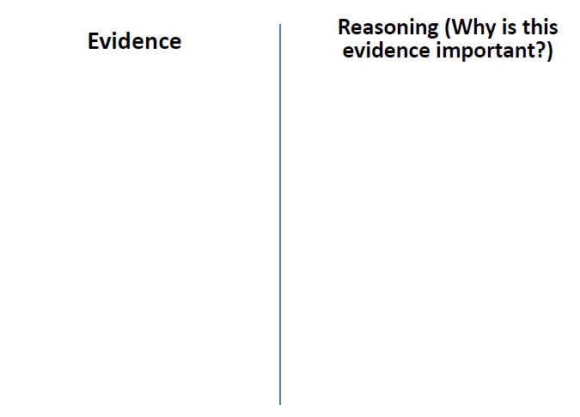
Time to Solve a Mystery!
*Think about your claim, but you do not need to write it down at this moment.
Each person: needs to draw a line down the center of their paper. Find three pieces of evidence with reasoning
INB pg. 20

Slide 3
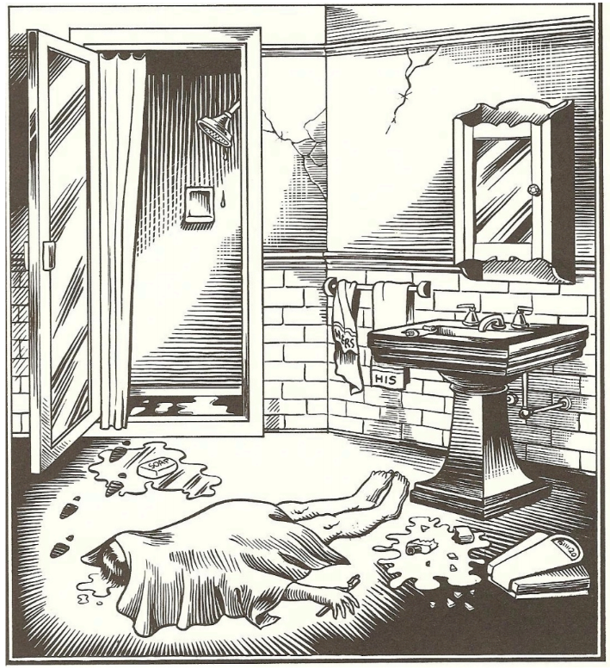
“Bathroom Blues”

Slide 4
“Bathroom Blues”
Experimental Question:
What happened in the bathroom?

Slide 5
On your White Board:
-state your claim
-create this diagram with your evidence
and reasoning. (Be prepared to share!)
-You can add pictures too!

Slide 6
Board Meeting Protocol
Silent Review
1st round: Each team must state a similarity or difference of their board and another teams.
What is similarities do we see? What do the boards have in common? What are some differences?
2nd round: Clarifying Questions
Each team must ask another team a clarifying
question about their board.
Why did you _____________?
How did you decided ______________?
How does _________ evidence support your claim?

Slide 7
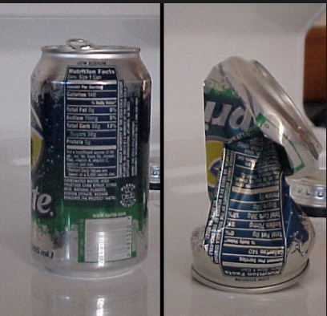
Air Pressure Demo
INB pg. 20
Question: Why did the can crush?
Claim: One sentence
Evidence: what did you see? What was happening to the air molecules inside & outside of the can?
Reasoning: Include a scientific principle… temperature, movement of molecules, density, pressure!

