Slide 1
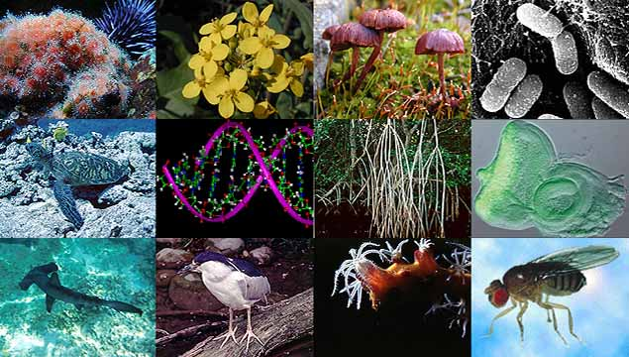
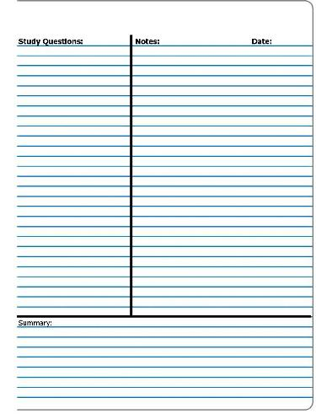
Title: CHARACTERISTICS OF LIFE
INB page. 6
Essential Question:
If you encounter an unknown substance, how will you determine if it is living or nonliving?

Slide 2


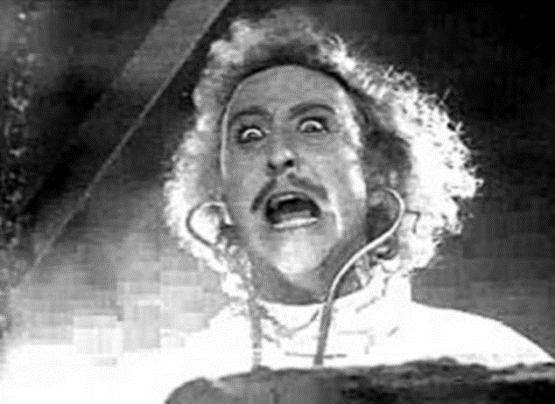
A. All living things…..

Slide 3
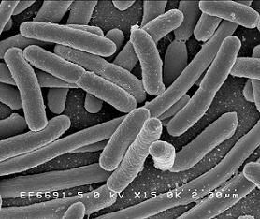
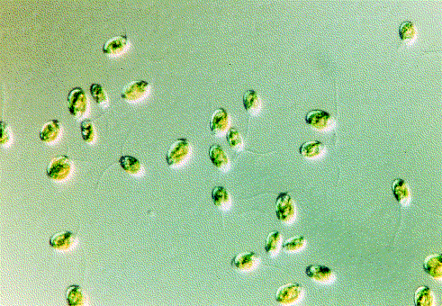

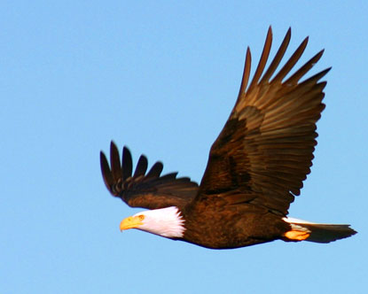
1. Are Organized: MADE OF CELLS (smallest unit of life)
Unicellular – single cell
Ex. bacteria, protists
Multicellular – many cells
  Ex. plants, animals

Slide 4
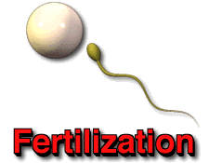
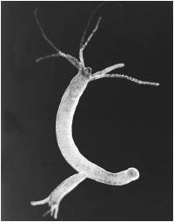

2. REPRODUCE
SEXUAL – offspring comes from 2 parents
ex. humans, plants, mammals
ASEXUAL – offspring comes from 1 parent
  ex. bacteria, yeast

Slide 5
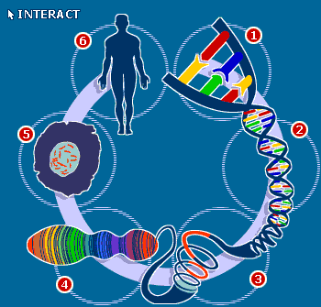
3. Pass on genetic information through DNA

Slide 6
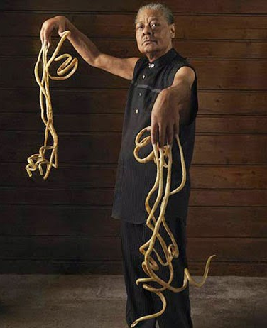
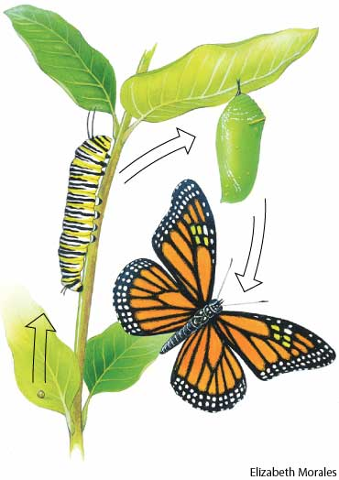
4. GROW AND DEVELOP

Slide 7
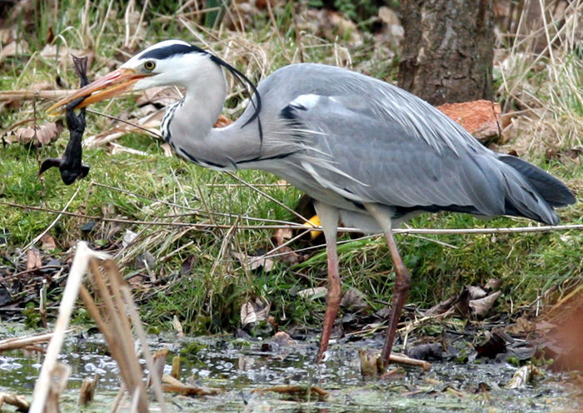
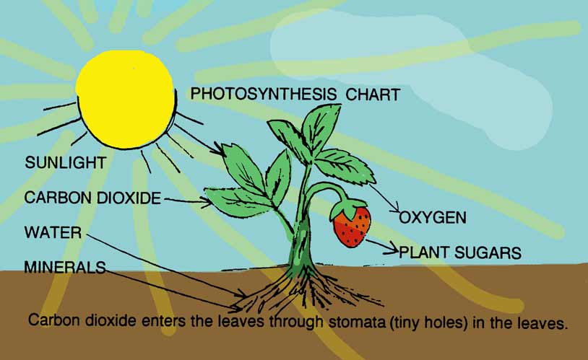
5. obtain and use ENERGY
  To grow, develop, repair and reproduce

Slide 8

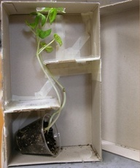
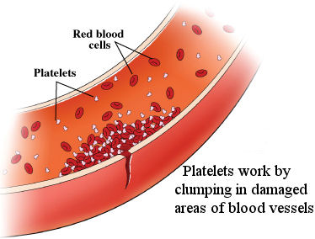
6. Respond to STIMULI (event that evokes a response)
Ex. Odor, light, temperature, moisture

Slide 9
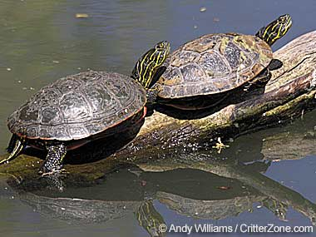
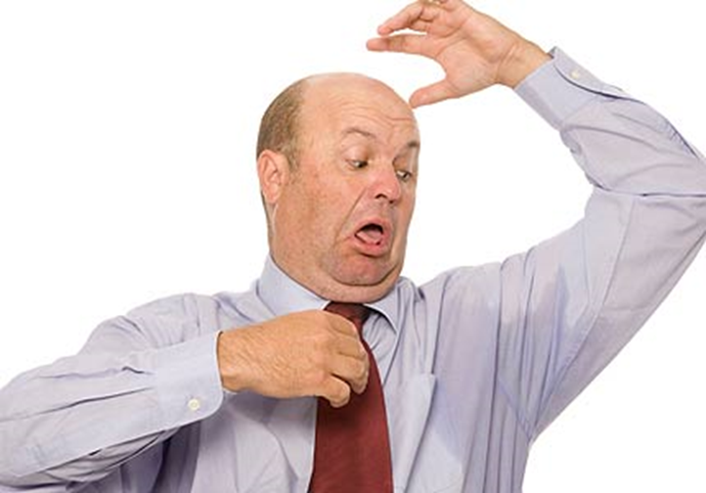

7. maintain an internal BALANCE
HOMEOSTASIS – stable condition
Ex. Sun bathing, fever, shivering

Slide 10
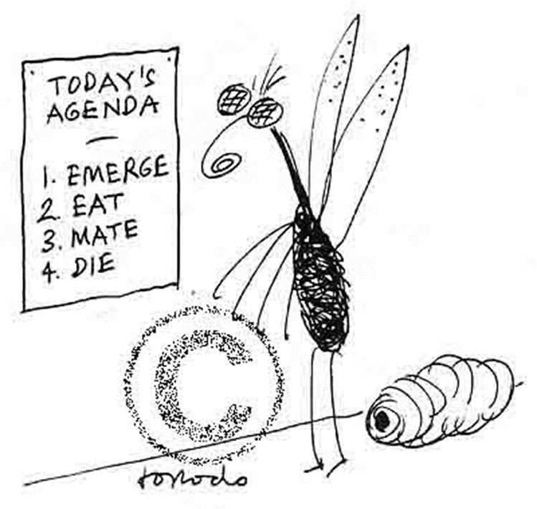
8. Die

Slide 11
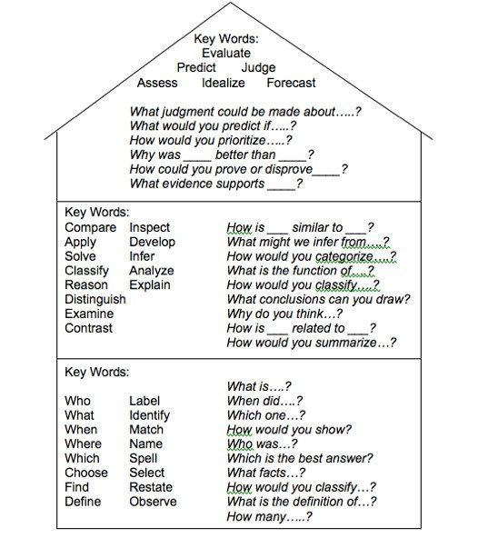
Level’s of Questions
*Create 5 “Quiz/study” questions in the question column of your notes.
You must create at least TWO level 2 questions.
3.
2.
1.

