Slide 1
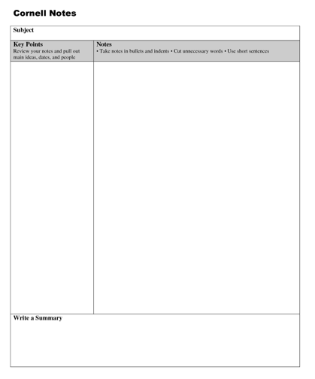
EQ: How does evidence and reasoning strengthen a scientific claim?
Title: Experimental Design & Conclusion Notes
INB page. 9

Slide 2
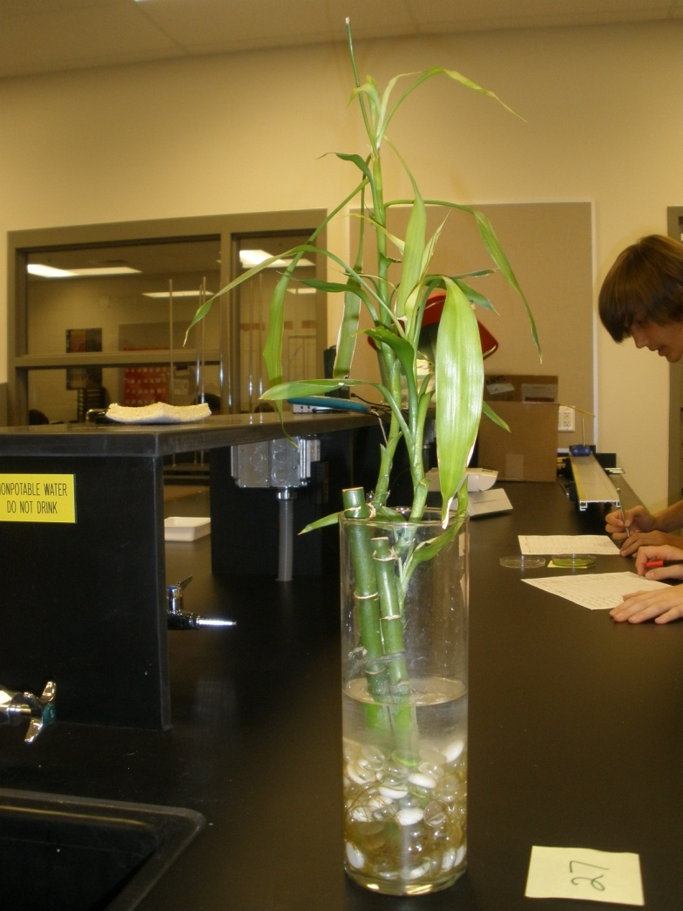
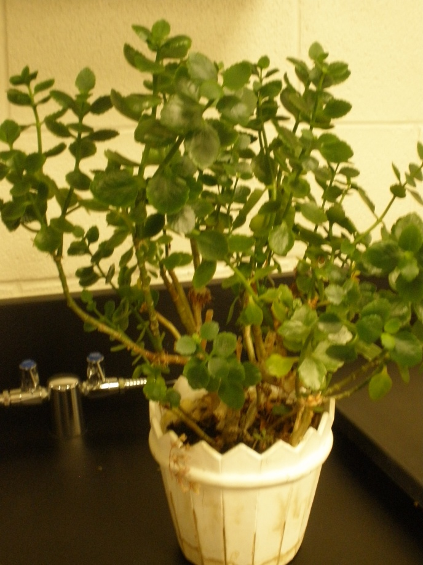
A. Experimental Design
1. Observations- undisputed fact based off senses.
Quantitative- descriptions with numbers [ex. He is 6’11” tall]
Qualitative- descriptions without numbers [ex. He is really tall]
Inference- description based on previous knowledge.
Do you remember from last year?

Slide 3
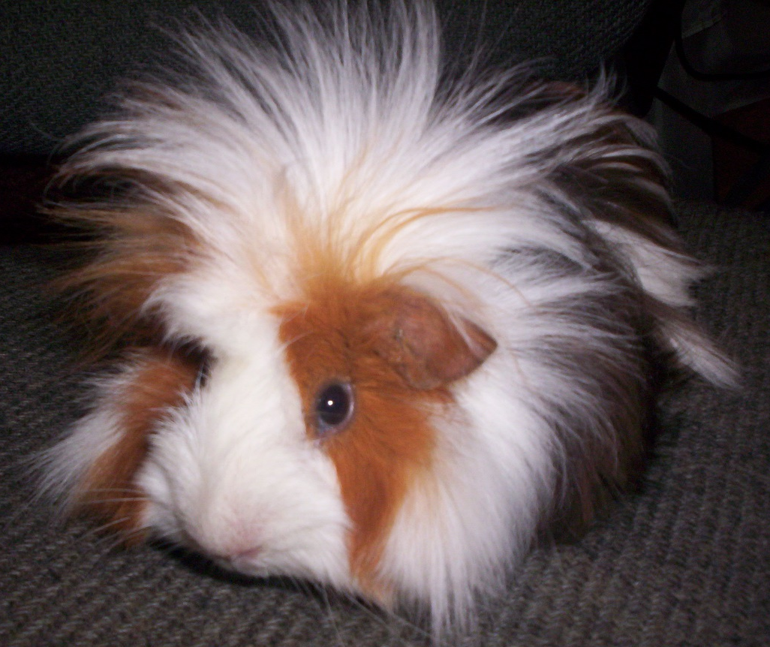
2. Factors that influence an experiment
a. Manipulated/independent variable- something that you intentionally change…..ONLY ONE
b. Responding/dependent variable- being measured, changing in response to manipulated variable
c. constant variables: kept the same throughout experiment
d. control group: group that DOES NOT get the manipulated change
MV?
RV?
3 constants
Control Group?
Let’s Practice!
Four guinea pigs are kept at different temperatures for six weeks. At the end of 6 weeks, percent weight gain is recorded. A fifth guinea pig is kept normal room temperature of 20oC
Constants: cage, species of guinea pig, diet, time of day pigs are weighed,

Slide 4
3. Hypothesis- educated guess which can be TESTED
a. IF (manipulated variable), THEN (this will happen/responding variable) BECAUSE…..

Slide 5
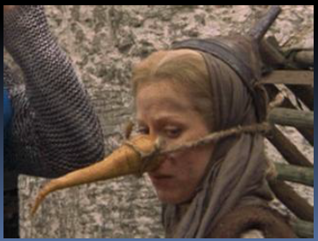
Claim-Evidence-Reasoning
INB page. 9 (bottom of pg)
Experimental Question: “Is she a witch?”
*Watch the following video clip & create a claim with evidence & reasoning.
Claim:
Evidence:
Reasoning:

Slide 6
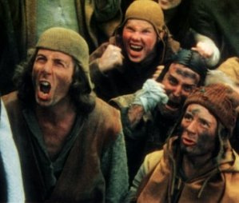
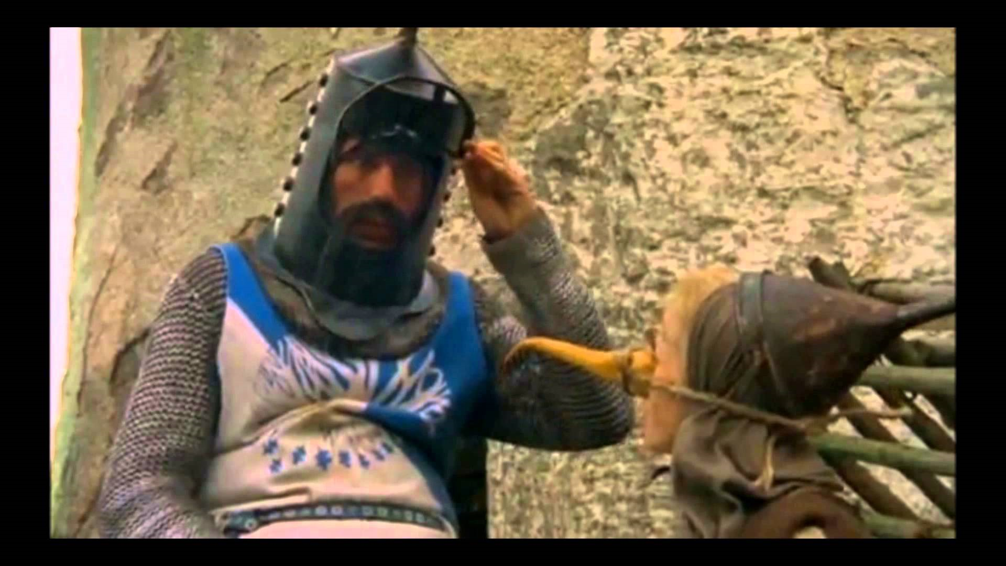
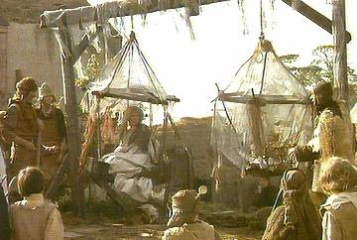
4. Conclusion (C-E-R)
a. Claim: one sentence that answers the experimental question
ex. She’s a witch and made of wood.!
b. Evidence: observations/data to support the claim
ex. Woman has the same weight as a duck. Both ducks and wood float.
c. Reasoning: how/why the data supports the claim (includes scientific principles)
ex. The woman weighs as much as a duck, therefore she must be made of wood and will burn.

Slide 7
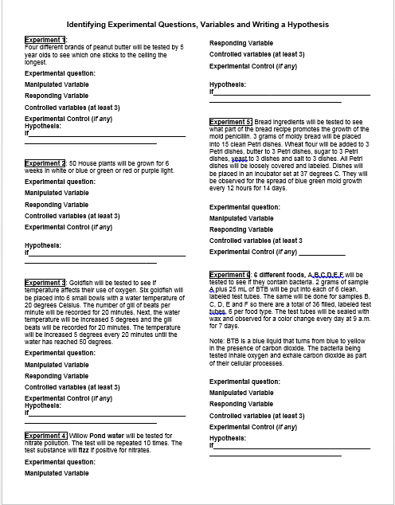
Title: Experimental Design Practice
INB page. 8
When you finish Experiment 1…come up to the front and check your answers with Mrs. O’s answer key.

Slide 8
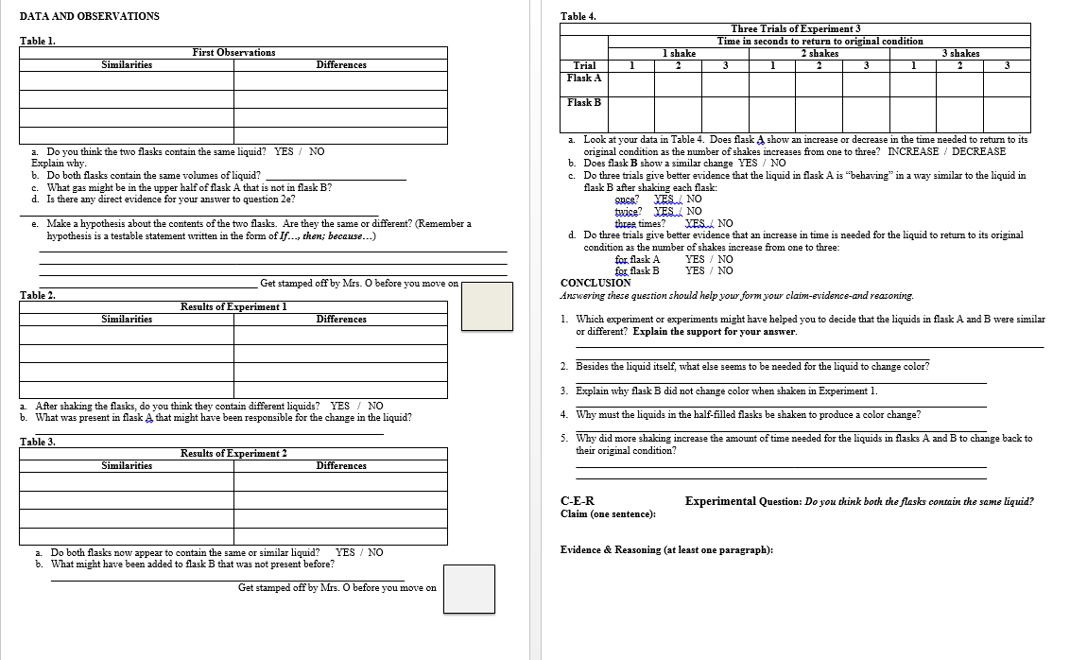
Bottle Experiment
INB page. 10
INB page. 11

Slide 9
Bottle Experiment
Move Desks into groups.
Read through Lab instructions with your partner/group
Get and WEAR goggles…MANDATORY
Get and wear gloves…..MANDATORY
Safety Rules:
-No goofing around or being careless. These are real chemicals.
-No opening bottles or bags when shaking!!!
-During experiment 2: come over to Mrs. O.
-When in doubt…Run water over skin!
-Return ALL bottles to lab counter by the microwave. THEN, pull off gloves from the wrist and throw in large trash can. THEN remove goggles!
-Every student will use WATER ONLY after lab.

Slide 10
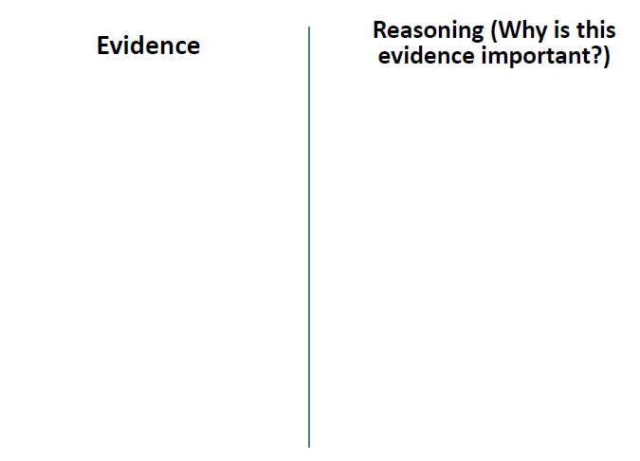
Time to Solve a Mystery!
*Each PAIR:
-two whiteboards
-two erasers
-three DIFFERENT colored dry erase markers
Each person: needs to draw a line down the center of their board. Find three pieces of evidence with reasoning

Slide 11
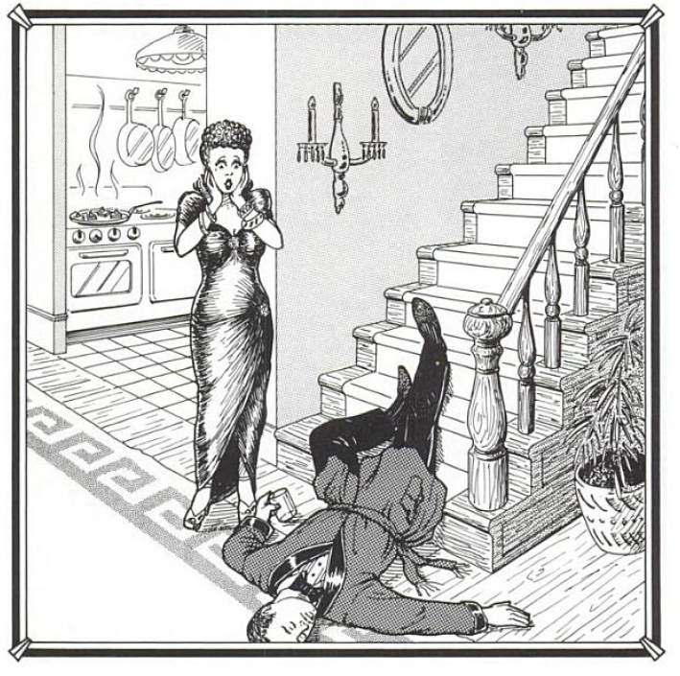
“Slip or Trip”
Queenie says that Arthur slipped and fell to his death. Is Queenie telling the truth?

Slide 12
2nd Board:
-state your claim
-create this diagram with your evidence
and reasoning. (Be prepared to share!)
-You can add pictures too!

Slide 13
Board Meeting Protocol
Silent Review
1st round: Each team must state a similarity or difference of their board and another teams.
What is similarities do we see? What do the boards have in common? What are some differences?
2nd round: Clarifying Questions
Each team must ask another team a clarifying
question about their board.
Why did you _____________?
How did you decided ______________?
How does _________ evidence support your claim?

Slide 14
Question: “Is the little girl’s dad an alien?”
Alien definition: alien is "an unfamiliar and disturbing being from another world"
http://viewpure.com/WQTsue0lKBk?start=0&end=0
-Watch the video & take “notes.”
-In paragraph form (4 sentences):
State your claim…highlight it or shade lightly with a colored pencil!
Support with evidence and reasoning
Circle any evidence
Underline any reasoning

Slide 15
EQ: How does evidence and reasoning strengthen a scientific claim?
Title: Experimental Design & Conclusion Notes
INB page. 9

Slide 16
A. Experimental Design
1. Observations- undisputed fact based off senses.
Quantitative- descriptions with numbers [ex. He is 6’11” tall]
Qualitative- descriptions without numbers [ex. He is really tall]
Inference- description based on previous knowledge.
Do you remember from last year?

Slide 17
2. Factors that influence an experiment
a. Manipulated/independent variable- something that you intentionally change…..ONLY ONE
b. Responding/dependent variable- being measured, changing in response to manipulated variable
c. constant variables: kept the same throughout experiment
d. control group: group that DOES NOT get the manipulated change
MV?
RV?
3 constants
Control Group?
Let’s Practice!
Four guinea pigs are kept at different temperatures for six weeks. At the end of 6 weeks, percent weight gain is recorded. A fifth guinea pig is kept normal room temperature of 20oC
Constants: cage, species of guinea pig, diet, time of day pigs are weighed,

Slide 18
3. Hypothesis- educated guess which can be TESTED
a. IF (manipulated variable), THEN (this will happen/responding variable) BECAUSE…..

Slide 19
Claim-Evidence-Reasoning
INB page. 9 (bottom of pg)
Experimental Question: “Is she a witch?”
*Watch the following video clip & create a claim with evidence & reasoning.
Claim:
Evidence:
Reasoning:

Slide 20
4. Conclusion (C-E-R)
a. Claim: one sentence that answers the experimental question
ex. She’s a witch and made of wood.!
b. Evidence: observations/data to support the claim
ex. Woman has the same weight as a duck. Both ducks and wood float.
c. Reasoning: how/why the data supports the claim (includes scientific principles)
ex. The woman weighs as much as a duck, therefore she must be made of wood and will burn.

